Slide 1
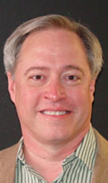
ELEC 220 Project Report
TEAM: ALARM 220
DATE: 04/03/2017

Slide 2




Liwen Jiang(EE)
Shuaicheng Li(EE)
Our Team
TEXT2
Zichuan Gong(CS)
Chuang Yu(EE)
Notes:
contents

Slide 3
Device Components
Overheat Alarm
Cable
Launchpad
Cable
Buzzer
Temperature Sensor
Overheat Alarm
4-Digit Display
Notes:
Member introduction

Slide 4
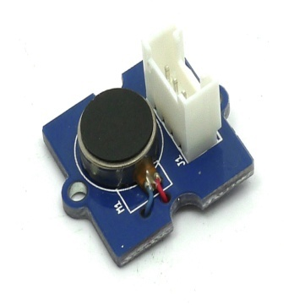
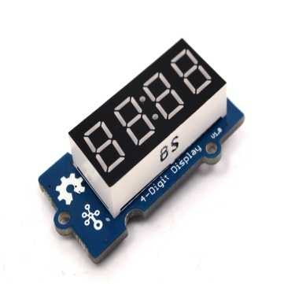
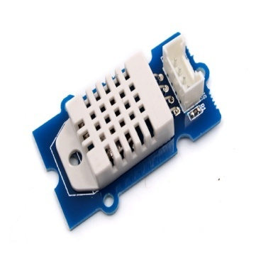
Device Function
Alarm
Show Temperature
Sense Overheat Situation

Slide 5
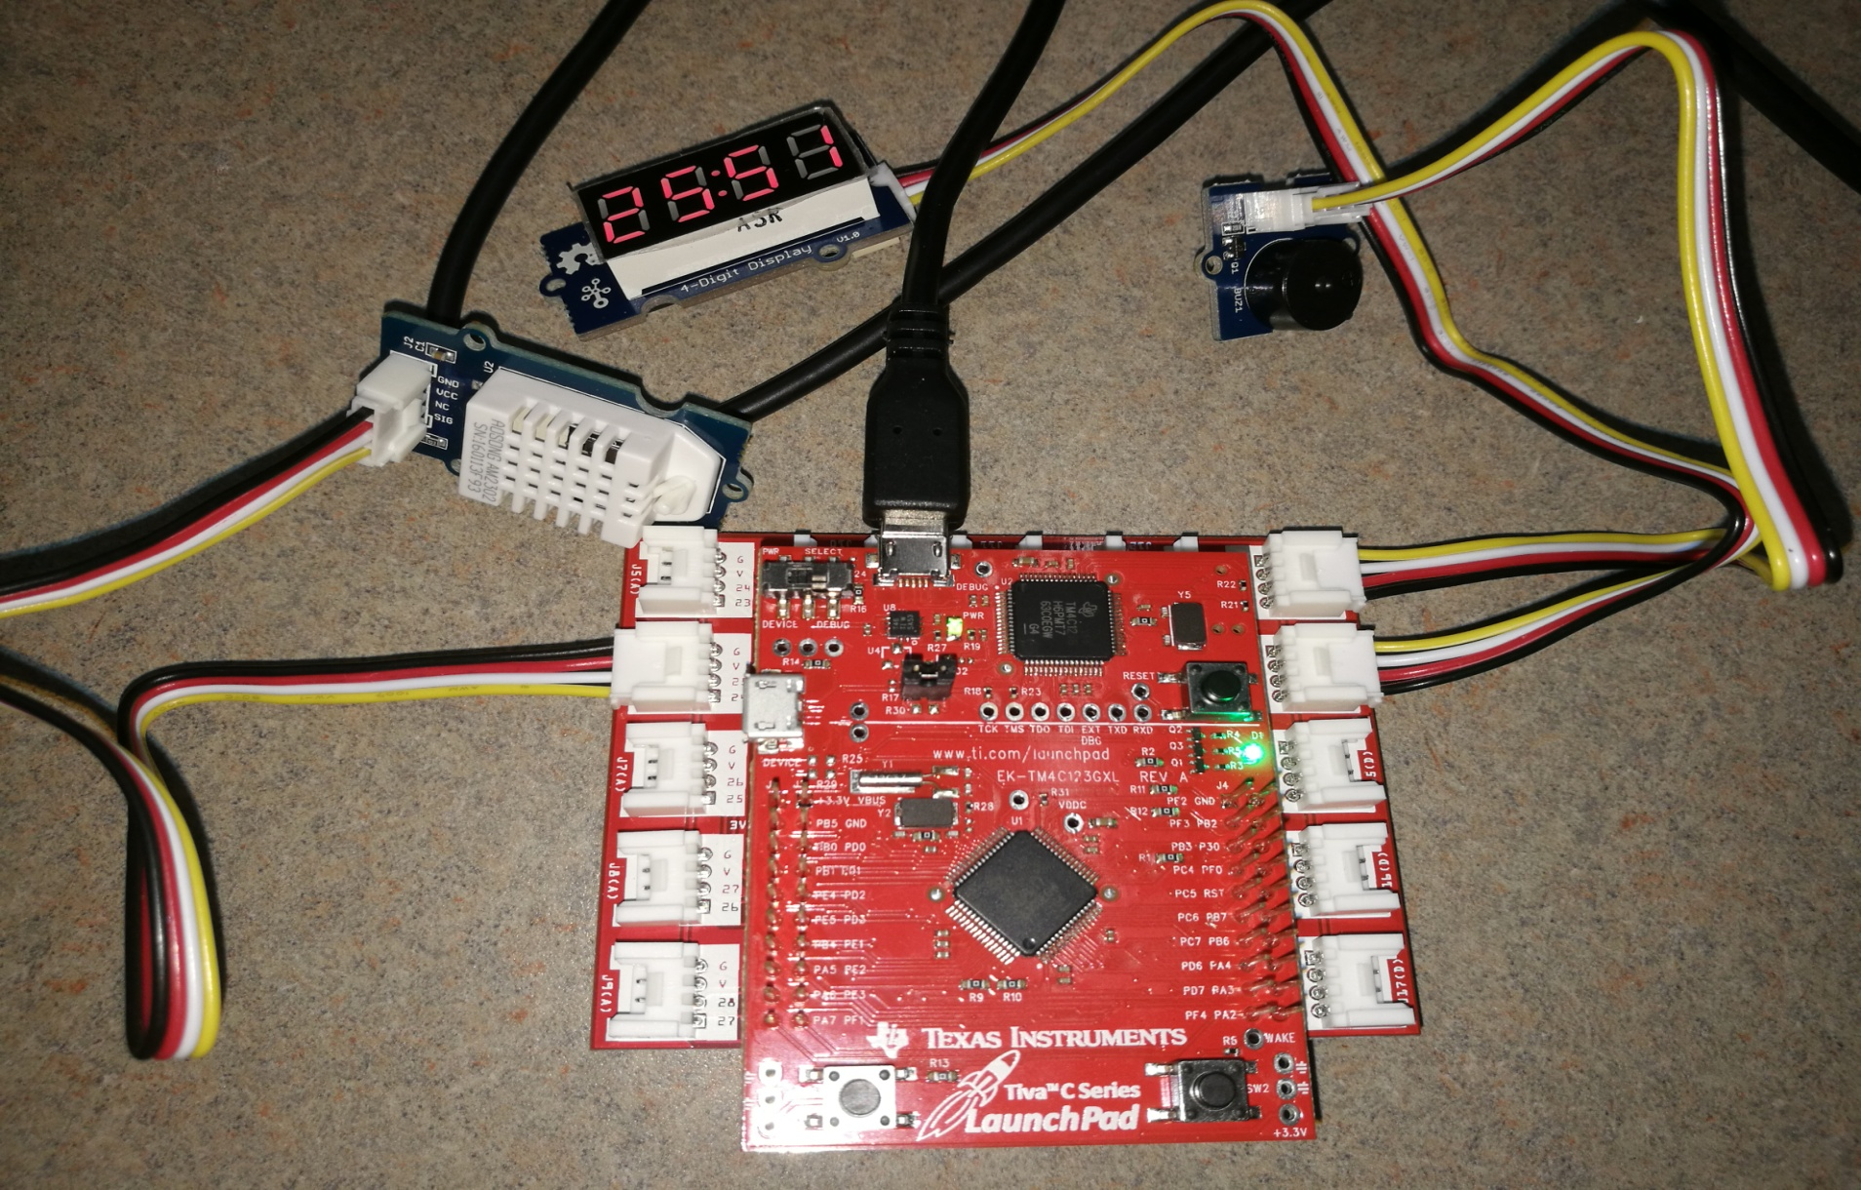
Demo Time ! ! !

Slide 6

Show Our Gratitude to……
The gentle Asian girl who can speak Chinese (maybe Laura ? )
The legend-like graduate -- Chance ! ! !
one
three
Friendly Doctor Simar
Other patient TAs who I forget names
The helpful Will Rice man -- Robby ! ! !
two
Others

